Slide 1
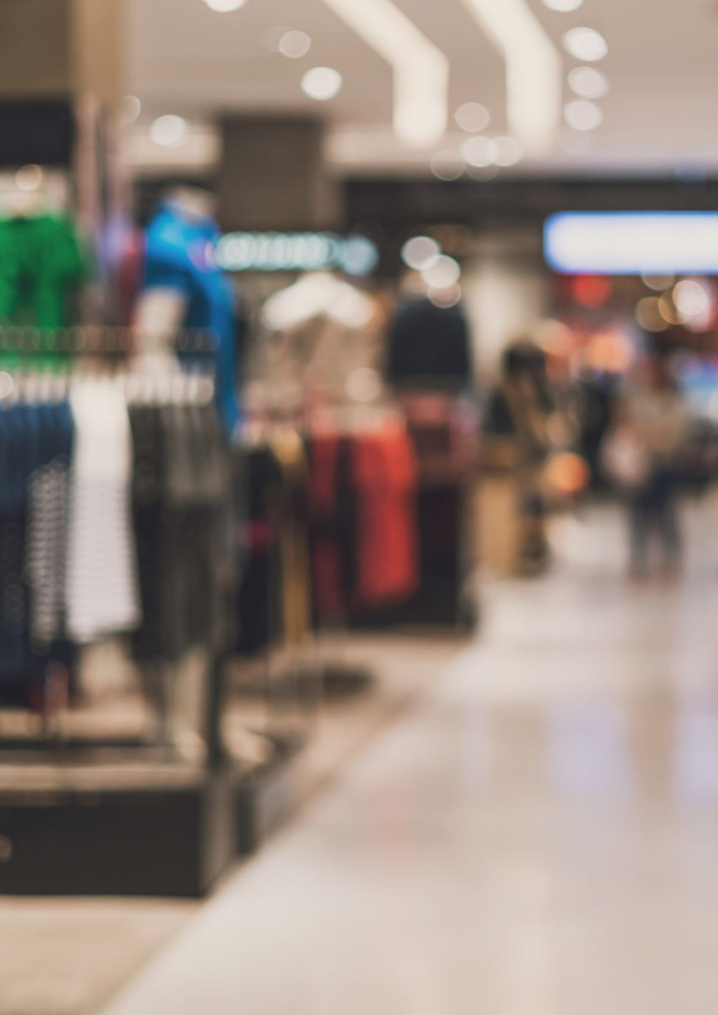
Store Item Demand Forecasting
Amir Parizi

Slide 2
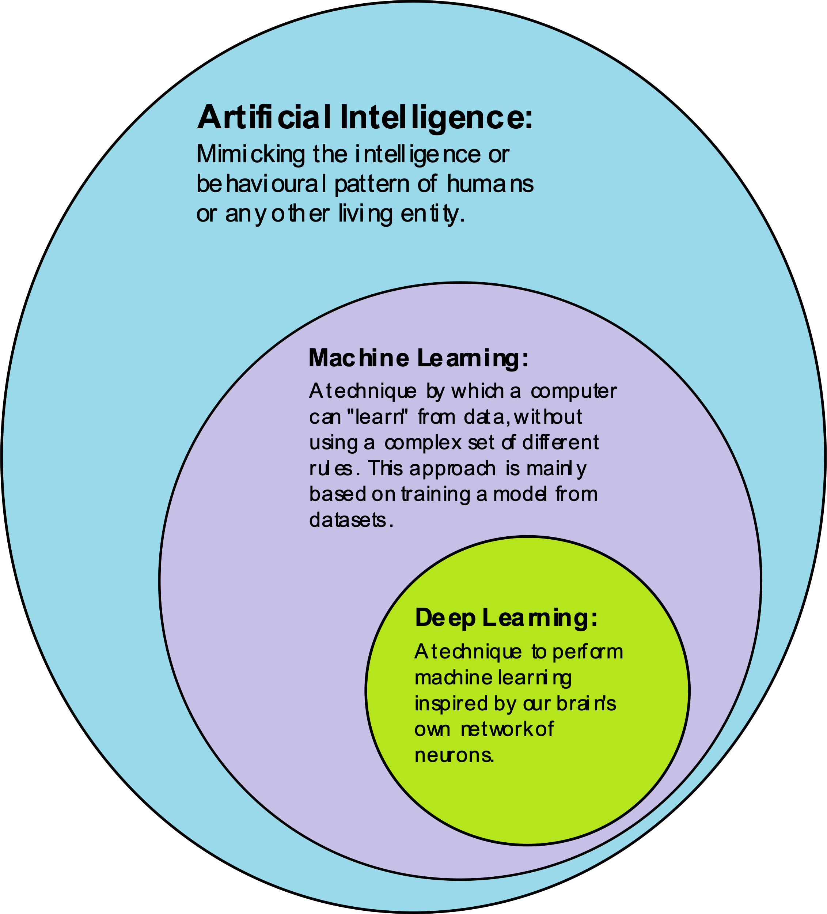
Machine Learning
Machine learning (ML) is a type of artificial intelligence (AI) that allows software applications to become more accurate at predicting outcomes without being explicitly programmed to do so.
Machine learning algorithms use historical data as input to predict new output values

Slide 3
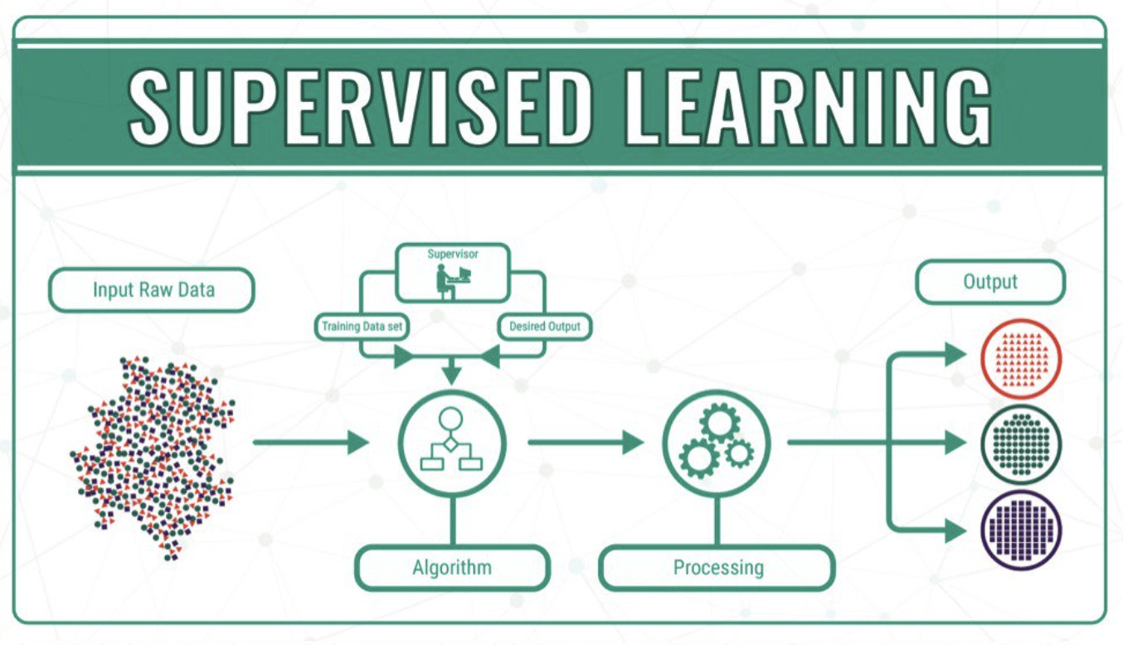
Learning Types
• General supervised learning problem: – Take features of objects and corresponding labels as inputs. – Find a model that can accurately predict the labels of new objects.
• This is the most successful machine learning technique: – Spam filtering, optical character recognition, Microsoft Kinect, speech recognition, classifying tumours, etc.

Slide 4
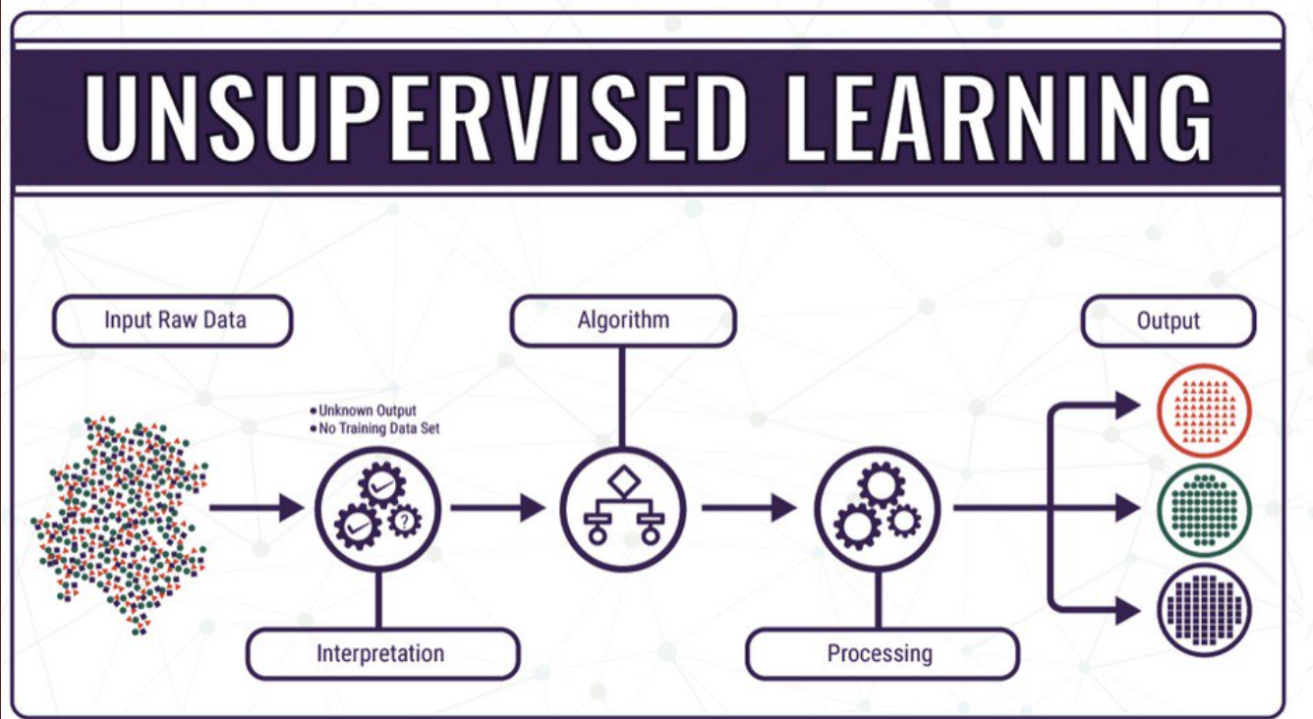
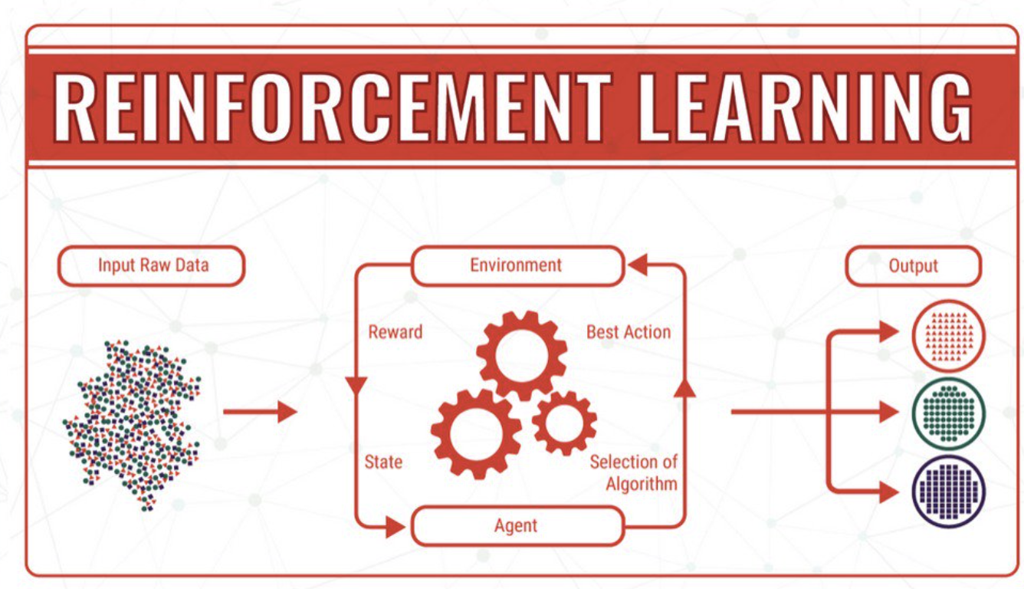
Learning Types
Unsupervised Learning is a machine learning technique in which the users do not need to supervise the model. Instead, it allows the model to work on its own to discover patterns and information that was previously undetected.
It mainly deals with the unlabelled data.
Reinforcement learning (RL) is an area of machine learning concerned with how intelligent agents ought to take actions in an environment in order to maximize the notion of cumulative reward.

Slide 5
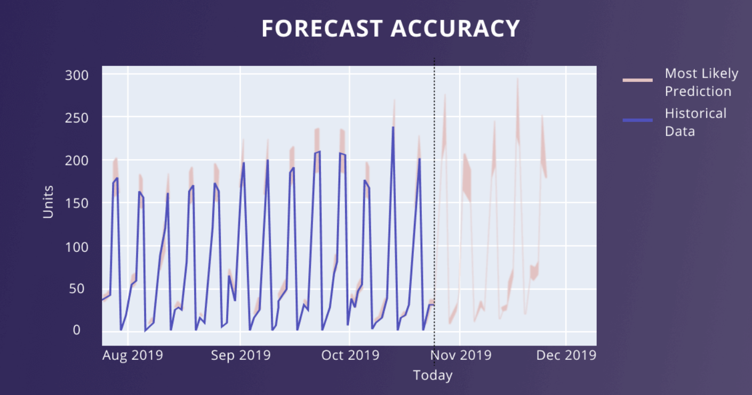
Forecasting
Forecasting refers to the practice of predicting what will happen in the future by taking into consideration events in the past and present. Basically, it is a decision-making tool that helps businesses cope with the impact of the future's uncertainty by examining historical data.
Machine Learning Techniques allows for predicting the amount of products/services to be purchased during a defined future period

Slide 6
Forecasting with Statistical Models
Demo Jupiter Notebook – Part 1

Slide 7
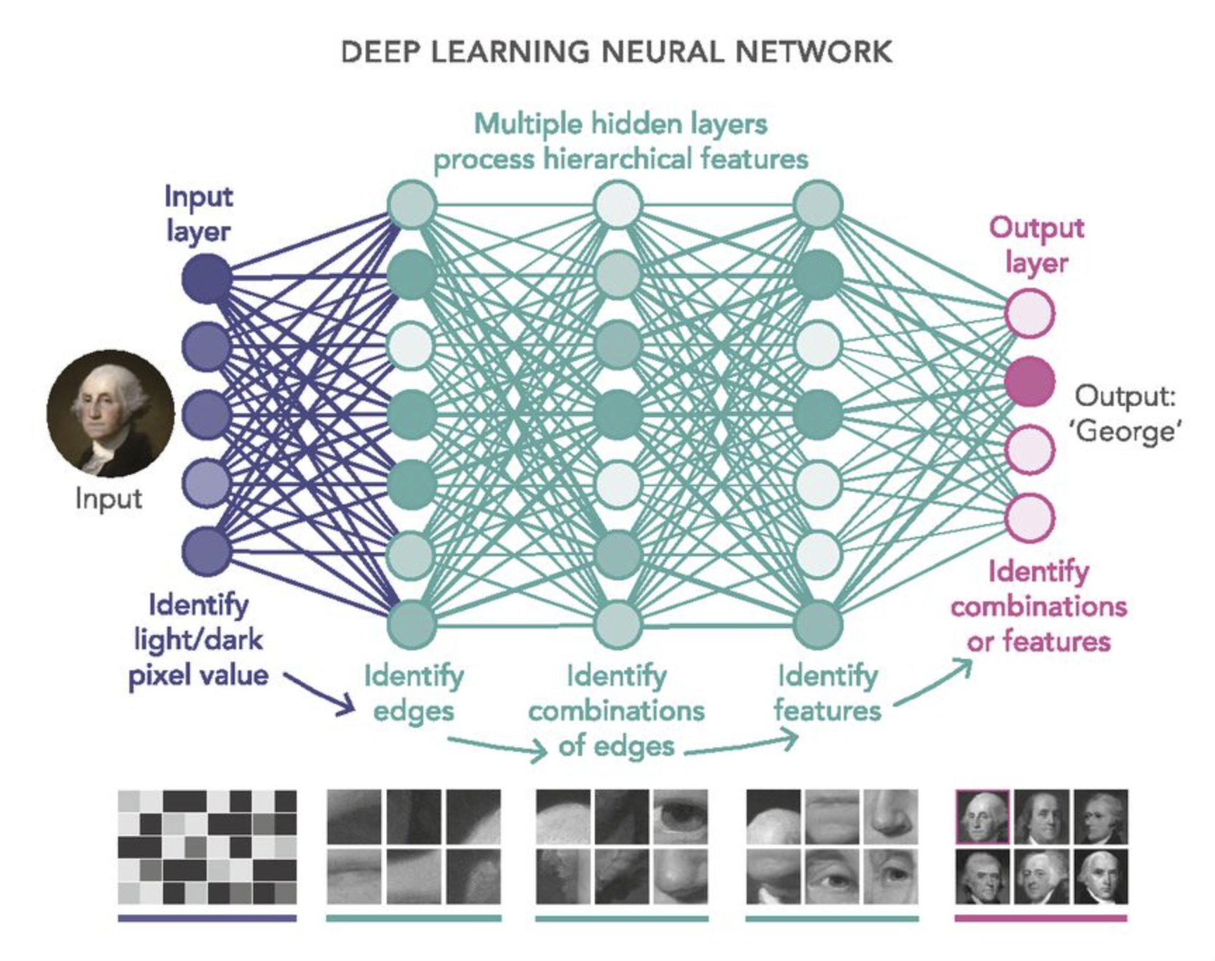
Deep Learning
Subset of Machine Learning
Neural Network with three or more layers
Layers attempt to learn from large amount of data
Additional hidden layers can help to optimize and refine for accuracy.
Deep learning methods offer a lot of promise for time series forecasting, such as the automatic learning of temporal dependence and the automatic handling of temporal structures like trends and seasonality.

Slide 8
Forecasting with Deep Learning Models
Demo Jupiter Notebook – Part 2

